Slide 1
Riding While Blind
Enhancing the Public Transportation Experience for Riders Who are Blind or Visually Impaired

Slide 2
Office of Vocational Rehabilitation
Mission: To assist Pennsylvanians with disabilities to secure and maintain employment and independence.
15 District Offices
Bureau of Blindness and Visual Services
6 District Offices

Slide 3
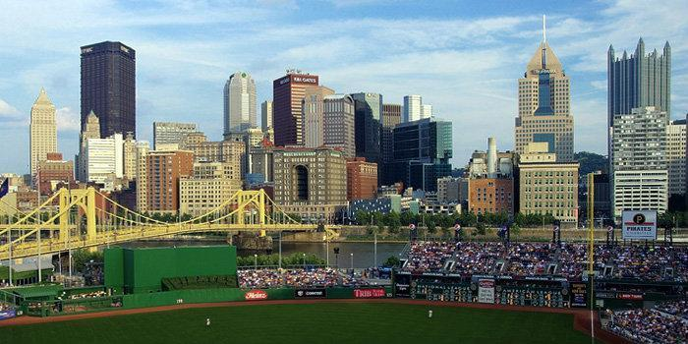
2013 American Community Survey estimated that 6.3% of Pennsylvania's population has a visual impairment.
791,870 people = 2 x the population of the city of Pittsburgh
126,694 are 65 +

Slide 4
VISUAL IMPAIRMENT
Definition:
Visual impairment includes a range of vision loss, from low vision to total blindness, that reduces a person's ability to function at certain or all tasks.

Slide 5
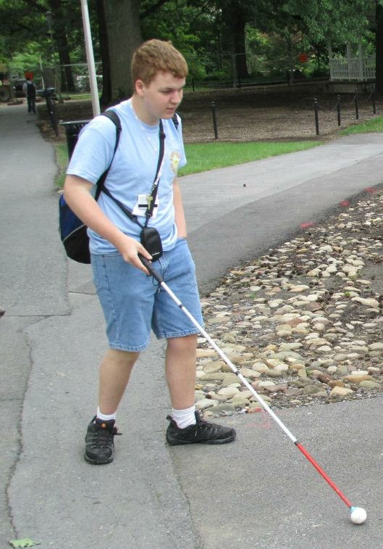
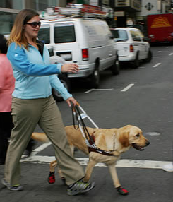
How to identify a person with a VISUAL IMPAIRMENT

Slide 6
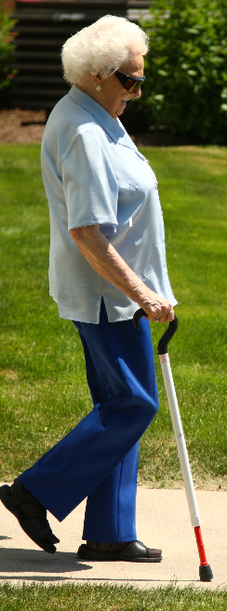

Slide 7
We asked BBVS staff and customers who are visually impaired:
What are the issues you have when using public transportation to access:
employment?
daily living activities?

Slide 8
Issue #1: Lack of sensitivity
Insensitive remarks and questions
Limited understanding of the impact of vision loss on a person’s mobility
Drivers, Conductors, Customer Service
Disability Awareness, Etiquette and Sensitivity Training

Slide 9
Issue #2: Accessibility issues
Some paratransit programs require in-person applications
No means of electronic application
Safety aspects of bus stop locations

Slide 10
Make websites, schedules, routes, and applications accessible
Provide technical training regarding accessibility issues
Consistent use of location annunciators
Partner with planners and businesses when creating fixed routes

Slide 11
Issue #3: Limited service areas
Limited fixed route availability
Limited service areas
Service does not cross county lines

Slide 12
Increase availability of on-demand ride service areas
Circular routes rather than linear routes on fixed lines
Work with employers to establish dedicated routes for employees

Slide 13
Issue #4: Paratransit/Shared Ride
Door-to-door trips can be very long for a short destination
Consider partnering with private enterprises (such as Uber and Lyft) to provide on-demand transportation in rural and underserved areas /times

Slide 14
Issue #5: Hours of Operation
No or limited weekend services
Limited evening services
Expand hours of operation
Work with employers to determine scheduling needs

Slide 15
Resource
Orientation and Mobility Instructors (O&M) - experts in transportation and travel for individuals with visual impairments
Bureau of Blindness and Visual Services
6 District Offices
bbvs@pa.gov

Slide 16
Enhancing the Public Transportation Experience for Riders Who are Blind or Visually Impaired
Thank you!

