Slide 1
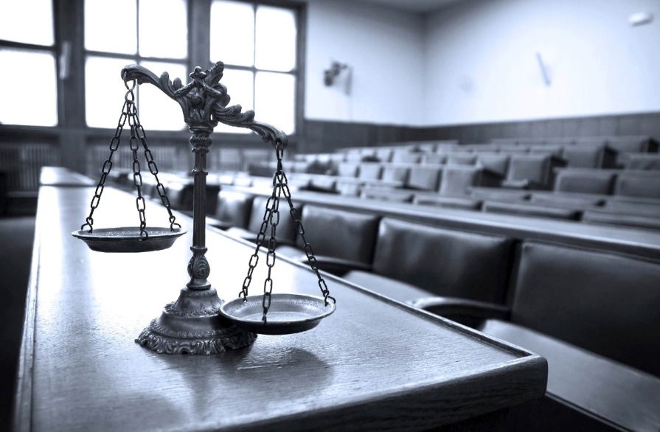
Public Transportation Association
Collective Bargaining Bonanza
Presented by:
Anthony T Bowser, Esquire
Thomas, Thomas & Hafer LLP
305 N Front Street, 6FL
Harrisburg, PA 17101
www.tthlaw.com

Slide 2
The Laws
2
2
State: PA Public Employe Relations Act (PERA)
Most local government employees
Separate rules for police, teachers
Federal: National Labor Relations Act (NLRA)
Most non-gov’t employees

Slide 3
The Agencies
3
3
PA Labor Relations Board (PLRB)
Enforces and oversees PERA (and PLRA)
National Labor Relations Board (NLRB)
Enforces and oversees NRLA

Slide 4
Certification
4
4
By agreement under§602
Form petition
Board must still find the unit to be appropriate

Slide 5
Certification

Slide 6
Certification
6
6
By election under §§603-605
30% or more in appropriate unit
If Employer contests, Board will conduct hearing
Election

Slide 7
Certification
7
7
Appropriateness of Unit
Identifiable community of interest
Prevent over-fragmentization
1st level supervisors excluded, but may form separate unit

Slide 8
Certification
8
8
Conduct of Election
At least 10 days notice
Secret ballot
Must include “no representative” as choice
Majority prevails
If no majority, run-off

Slide 9
Certification
9
9
Exclusive Representative
Wages
Hours
Terms and conditions of employment
Right to be present at grievances

Slide 10
Fair Share vs Right to Work
10
10
Abood v. Detroit Bd. of Educ.
Harris v Quinn

Slide 11
De-certification
11
11
Petition for de-cert§607
30% must support
Employer may file if good faith doubt of majority
90/60 rule
Elections for new representative only before expiration of agreement

Slide 12
Scope of Bargaining
12
12
Wages, hours and terms/conditions of employment
Must meet and confer in good faith
No obligation to accept a proposal

Slide 13
Scope of Bargaining
13
13
Managerial Policy (No obligation to bargain)
Polices that affect functioning of ER
Standards of services, overall budget, utilization of technology, the organizational structure and selection and direction of personnel
Must still meet & discuss if policy affects wages/hours/conditions

Slide 14
Scope of Bargaining
14
14
Hiring and Firing
Employer retains right to hire and fire for “just cause”

Slide 15
Collective Bargaining: Impasse Procedures
15
15

Slide 16
Collective Bargaining: Impasse Procedures
16
16
Mediation
Voluntary at any time
Mandatory at 150 days prior to “budget submission date”

Slide 17
Collective Bargaining: Impasse Procedures
17
17
Fact-finding
If no agreement after 21 days of mediation or 130 days prior to budget submission date
Appointment of fact-finding panel
Fact-finding “hearings”
Either party may accept or reject findings
Findings and recommendations published

Slide 18
Collective Bargaining: Impasse Procedures
18
18
Unfair Labor Practices during impasse procedures
Refusal to submit to mediation or fact-finding constitutes ULP

Slide 19
Collective Bargaining: Impasse Procedures
19
19
Voluntary binding arbitration
Advisory only if award would require legislative action
e.g. levying taxes to pay for wage increase

Slide 20
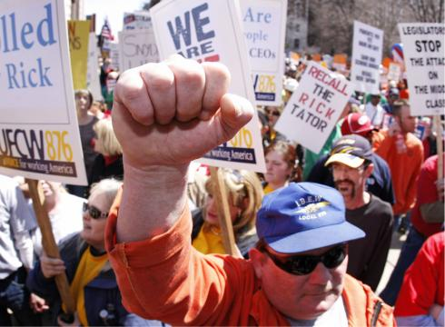
Collective Bargaining: Strikes
20
20
Employees cannot strike during mediation or fact-finding
May strike after exhaustion of impasse procedures

Slide 21
Collective Bargaining: Strikes
21
21
Court may enjoin otherwise legal strike if it presents “clear and present danger”

Slide 22
Grievances
22
22
Disputes arising out of interpretation of the Agreement
Procedure generally up to the parties
Last step must be binding arbitration

Slide 23
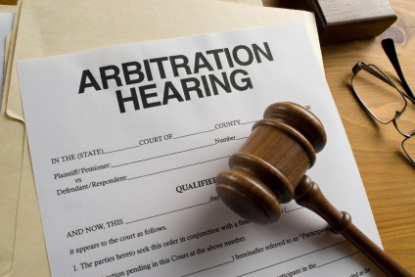
Grievance Arbitration
23
23
Selection of arbitrator
Costs shared by parties
Arbitrator has jurisdiction to determine arbitrability of issues
Past practices

Slide 24
Grievance Arbitration: Remedies
24
24
Remedy must be rationally derived from terms of CBA
Revision to disciplinary action
Damages: “make whole” remedy

Slide 25
Grievance Arbitration: Appeals
25
25
“Essence test” (high burden)
Where arbitrator is to determine the intention of the parties in their CBA, then the arbitrator's award is based on a resolution of a question of fact and will not be overturned if “the interpretation can in any rational way be derived from the agreement, viewed in light of its language, its context, and any other indicia of the parties' intention ....” Chambersburg Area Sch. Dist. v. Chambersburg Area Educ. Ass'n, 811 A.2d 78, 84 (Pa. Commw. Ct. 2002) aff'd, 578 Pa. 638, 854 A.2d 1277 (2004)

Slide 26
Unfair Labor Practices
26
26
Employers & Unions subject to ULP rules

Slide 27
Unfair Labor Practices
27
27
Interfering with exercise of collective bargaining rights
Interfering with formation of union
Retaliation for union activity
Refusing to bargain collectively in good faith with exclusive representative, including discussing grievances

Slide 28
Unfair Labor Practices
28
28
Refusing to reduce a collective bargaining agreement to writing and sign such agreement.
Violating election rules
Refusing to comply with the provisions of an arbitration award
Refusing to “meet and discuss”

Slide 29
Unfair Labor Practices
29
29
Specific examples of ULPs
Case loads / work loads
Discrimination
Refusal to produce information for grievance adjudication

Slide 30
Unfair Labor Practices
30
30
Transferring work out of bargaining unit
Must bargain to impasse first

Slide 31
Distressed Municipalities
Municipalities Financial Recovery Act (Act 47)
Cannot make changes to current CBA or interest arbitration awards
Can outline changes in future CBAs

Slide 32
Questions/Comments?
32
32

Slide 33
33
33
Anthony T Bowser, Esquire
Thomas, Thomas & Hafer LLP
305 N Front St
Harrisburg, PA 17101
717-441-3959
Twitter: @AnthonyBowser
abowser@tthlaw.com

