Slide 1
Pennsylvania Public Transportation Association (PPTA) Spring Conference
Green Light-Go Program
Pennsylvania’s Municipal Signal
Partnership Program
April 7, 2015
www.dot.state.pa.us/signals
Daniel Farley
Chief, Traffic Signal and Arterial Management Section
Bureau of and Operations
dfarley@pa.gov
(717) 783-0333

Slide 2
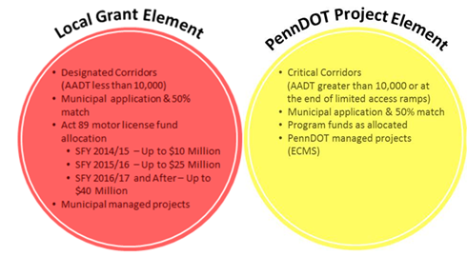
Green Light-Go Program
Program Objectives:
Sustainable funding for traffic signals on State Highways
Focus on safety and mobility concerns by reducing delay, motorist travel times, energy, gas consumption, and greenhouse gas emissions
Promote and encourage multi-municipal cooperation
Maintenance and Operations Accountability

Slide 3
Green Light-Go Program
Existing Traffic Signals on State Highways
Municipal completes an electronic application
At least 50% match using municipal or private cash
Local Grant Element – Municipal Managed Projects
PennDOT Project Element – PennDOT Managed Projects
Program Guidance available at: www.dot.state.pa.us/signals
Agreement to the Terms and Conditions, Signed agreement, traffic signal permit, and new TE-160 Form (Application for Traffic Signal Approval) required before an award

Slide 4
Green Light-Go Program
Notes:
Eligible Project Clarification:
Designated Corridors (Municipal Managed Projects):
Previous work completed cannot be submitted for full reimbursement.
Previous work completed can be used only for an application match with Department acceptance of the match.
Projects can be started, but award reimbursement will not be accepted until after municipal acceptance of the Green Light-Go Award offer if it is received. Prior work can be considered a match with Department acceptance of the match, but will not be reimbursed as part of the municipal award.
Critical Corridors (PennDOT Managed Projects):
Previous work completed cannot be submitted for full reimbursement.
Previous work completed can be used only for an application match with Department acceptance of the match.
Project design can be started and submitted to the Department, but Construction will not be considered.

Slide 5
Year 1 (SFY 14/15) Program Update
Focused on Retiming and LED upgrades
Up to $10 Million allocated
Municipal Application Period: September 27th to November 14th
72 Applications were received
26 Applications were determined to be Ineligible for Year 1
Ineligible applications will be automatically part of Year 2 and municipalities will be notified in the next few days
Year 1 Awards were announced in a December 22, 2014 Press release
Projects that were recommended will be given an Offer to confirm the 50% match submission and sign the program agreement
Central Office is performing a statewide Traffic Signal Asset Management Data Collection (ECMS Agreement E03463)

Slide 6
Traffic Signal Asset Management System (TSAMS)
District & Central Office
Planning Partners
Consulting Engineers
Contractors & Suppliers
TSAMS
Local Authorities
Defined User Roles
GIS Interface
Inventory Records
Web Accessible
Customer Complaints
Data and Life Cycle Analysis
Maintenance Activities
Planning
Reporting
Electronic Data Storage
Budgeting
System and Communications Mapping
Integration with other PennDOT Systems

Slide 7
Year 2 (SFY 15/16) Program Information
Added Maintenance and Upgrade activities
Up to $25 Million allocated
PA Bulletin Announcement on December 20th
Municipal Application Period: December 20th to February 27th
146 Applications from 119 Municipalities were received.
Addition of a program cost estimating document
Detailed program schedule is being established
Year 3 (SFY 16/17) – Up to $40 Million allocated (Anticipated to begin in the late Fall of 2015)

Slide 8
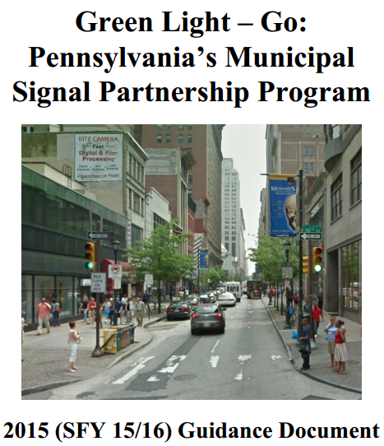
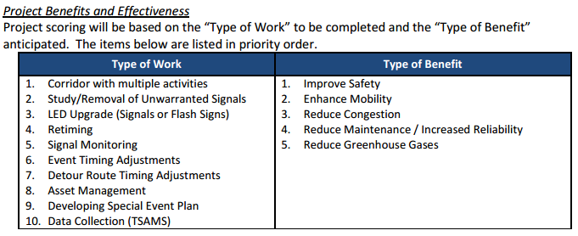
Scoring Criteria
Selection Team Scoring Criteria
Selection Criteria Description | Potential Score
Project Benefits & Effectiveness | 30
Local & Regional Impact | 15
Project Cost | 10
Leveraging of Funds | 10
Operations/Maintenance | 10
Evaluation by Others | 15
Other Priorities | 10
TOTAL: | 100

Slide 9
Application Guidance
Key Items to consider when completing an application:
Clarify the reason for the request, but also indicate how and why the proposed improvements would resolve an existing mobility and safety concern.
Inter-municipal cooperation is encouraged and will be given priority through the program.
Guidance documents outline the Department’s priorities
Application requests should be evaluated to determine whether critical and designated corridors should be in one project or two separate project requests.
Project Benefit Cost
Impacts to future maintenance and operations costs
Cost estimates should consider all aspects of the project (including inspection costs)

Slide 10
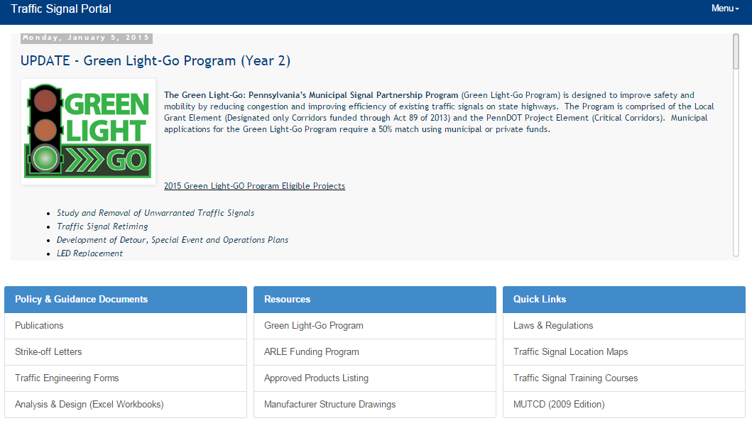
www.dot.state.pa.us/signals

Slide 11
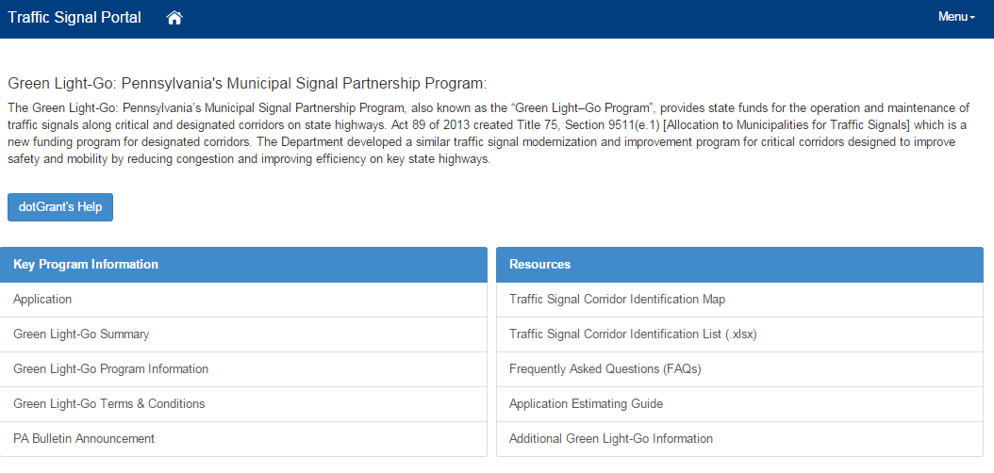
Green Light-Go Program Information
http://www.dot.state.pa.us/Portal%20Information/Traffic%20Signal%20Portal/FUNDGLG.html

Slide 12
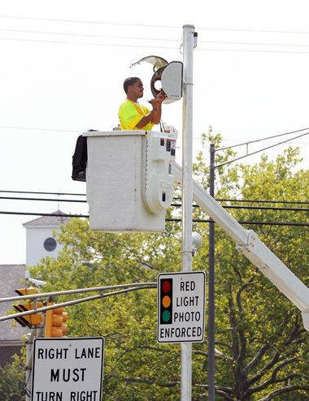
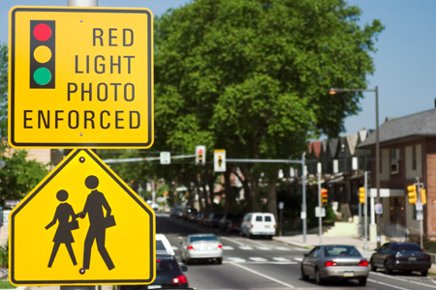
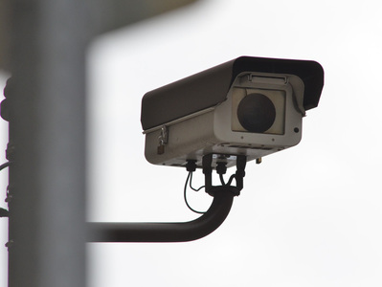
Pennsylvania Public Transportation Association (PPTA) Spring Conference
Automated Red Light Enforcement (ARLE) Funding Program
April 7, 2015
www.dot.state.pa.us/signals
Daniel Farley
Chief, Traffic Signal and Arterial Management Section
Bureau of and Operations
dfarley@pa.gov
(717) 783-0333

Slide 13
ARLE Funding Program Overview
Title 75 (Vehicle Code), §3116 allows City of Philadelphia to perform ARLE with the Secretary of Transportation approving each location.
Title 75, §3117 allows the City of Pittsburgh and certain municipalities in Bucks, Chester, Delaware, and Montgomery counties to perform ARLE with the Secretary of Transportation approving each location.
All revenue generated by ARLE (outside maintenance and operating costs) is sent to PennDOT to conduct a Grant Funding Program.
Title 67 (Pa Code), Chapter 233 is the ARLE Funding Program.

Slide 14
ARLE Eligible Applicants
Applicants Eligible for Grants As indicated in 67 Pa. Code §233.5 (Application procedure), a sponsor shall submit a grant application for eligibility in the ARLE Funding Program. Sponsors, as defined in 67 Pa. Code §233.2 (Definitions), may include the following:
Local authorities (counties, municipalities, and other local boards or bodies having authority to enact laws relating to traffic
Metropolitan Planning Organizations (MPOs)
Rural Planning Organizations (RPOs)
County planning organizations
Commonwealth agencies

Slide 15
ARLE Ineligible Projects
As indicated in 67 Pa. Code §233.3(c) (Eligibility requirements and criteria), all projects may be considered for the ARLE Funding Program, with the exception of transportation impact studies and highway improvements that are the responsibility of a privately funded applicant for a Department Highway Occupancy Permit. Inclusive projects that are not in line with the intent of this grant program will also be considered ineligible (e.g. large highway improvement projects such as new roads, bridges, interchanges, decorative street appurtenances, standard preventive or response maintenance, etc.).

Slide 16
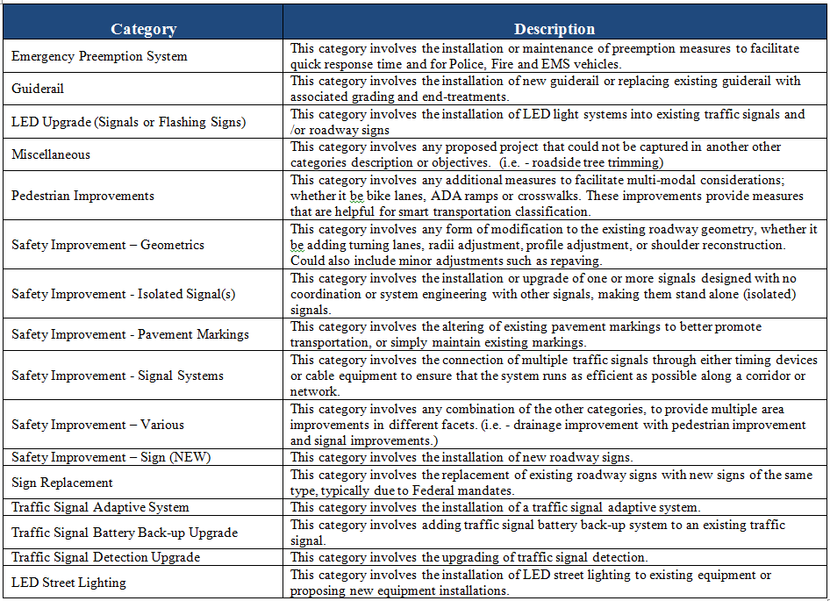
Previous Project Types

Slide 17
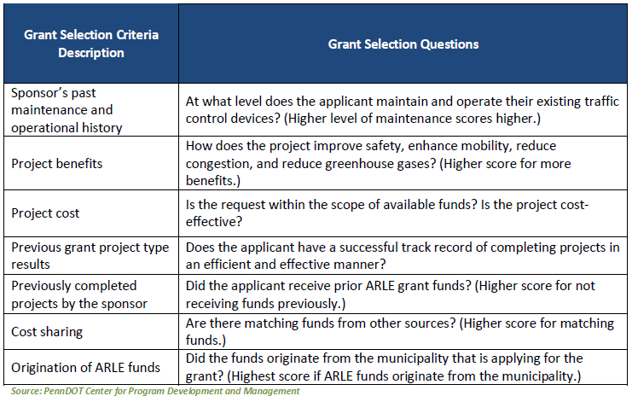
Evaluation Criteria

Slide 18
ARLE Funding Program Summary
 |  | TOTAL AVAILABLE | ARLE Application Information
Funding Year | Funds From Revenue Dates | TOTAL AWARDED | Total # of Applications Submitted | Total # of Funding Requested | Total # of Applications Awarded
2010 | 6/23/2005 to 11/30/2010 | $16,838,520 | 300 | $68,516,084 | 128
2011 | 11/30/2010 to 06/30/2011 | $2,999,168 | 307 | $27,311,041 | 27
2012 | 7/1/2011 to 6/30/2012 | $4,692,828 | 269 | $25,562,747 | 47
2013 | 7/1/2012 to 6/30/2013 | $8,798,895 | 131 | $22,757,702 | 32
2014 | 7/1/2013 to 6/30/2014 | $6,554,328 | 226 | $41,048,116 | 41
Totals: |  | $39,883,739 | 1,233 | $185,195,690 | 275

Slide 19
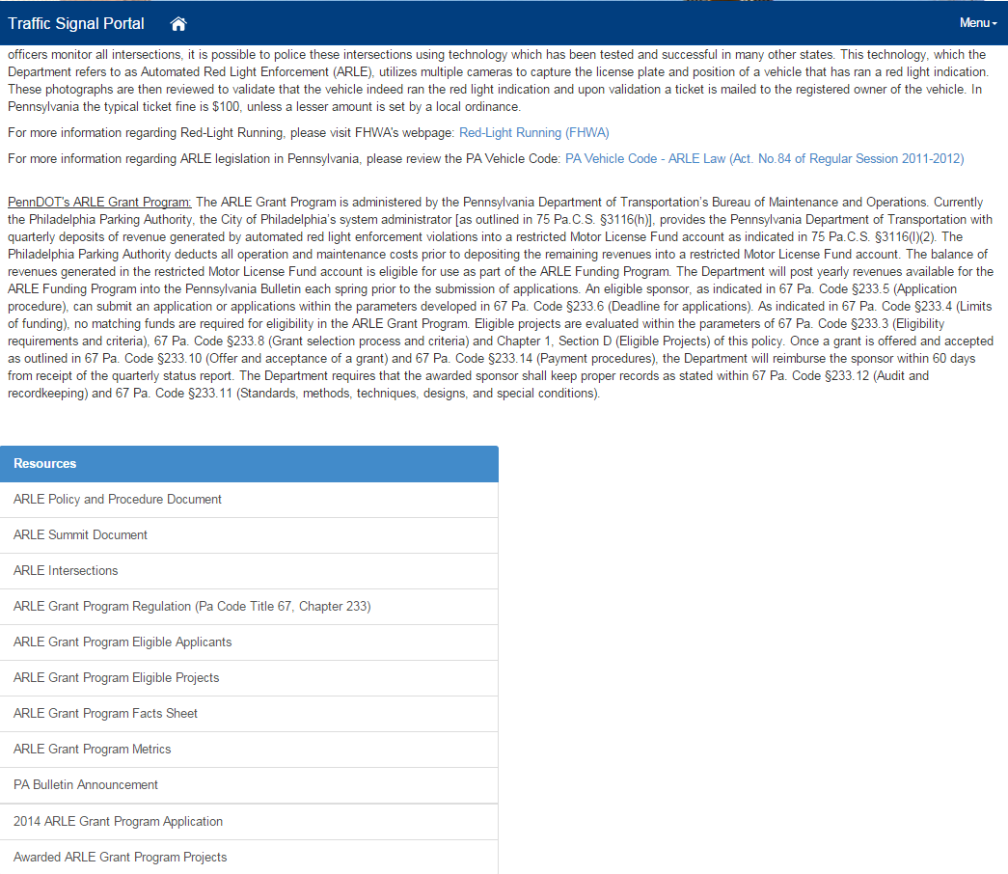
ARLE Funding Program Information

Slide 20
Traffic Signal Portal www.dot.state.pa.us/signals
Questions?
Daniel Farley
Chief, Traffic Signal and Arterial Management
PennDOT, Bureau of Maintenance and Operations
dfarley@pa.gov
(717) 783-0333
Green Light – Go Resource Account
RA-PDSIGNALFUNDING@pa.gov

