Slide 1
The ADA and Transportation
Kristi McLaughlin
Easter Seals Project Action Consulting
April 8, 2015

Slide 2
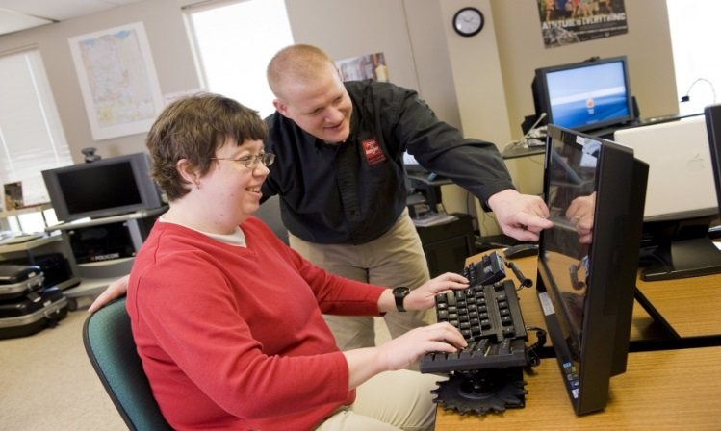
Notes:
Easter Seals is one of the largest providers of services in the disability field.
We have affiliates across the country
Services are provided to people of all ages and include:
Employment services
Mental health services
Occupational therapy
Physical therapy
Speech therapy
Recreation programs
Senior day programs
Early childhood development
Services for veterans and military families
Go to www.easterseals.com to locate the affiliate nearest to you.
Easter Seals also offers a number of programs from its national headquarters in Chicago and its office of public affairs in Washington, DC

Slide 3
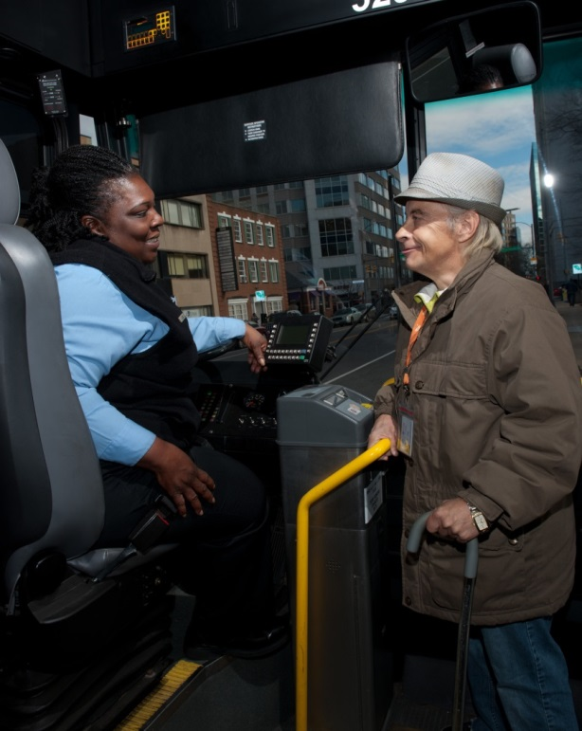
Easter Seals Transportation Group
Multiple projects focusing on:
Accessible transportation for people with disabilities
Transportation for older adults
Veterans’ transportation concerns
School transition programs and travel skills for students
Mobility management
Notes:
The Easter Seals Transportation Group includes several training and technical assistance projects focusing on:
Access for people with disabilities
Transportation needs for older adults
Veteran and military families
Youth and children
Mobility management
Travel training
Accessible communities
We offer training in face-to-face venues such as this as well as webinars and online courses.
We also provide technical assistance via our web site, 800 hotline and e-mail and we produce a number of products that are downloadable from our web site or can be ordered in hard copy if preferred.

Slide 4
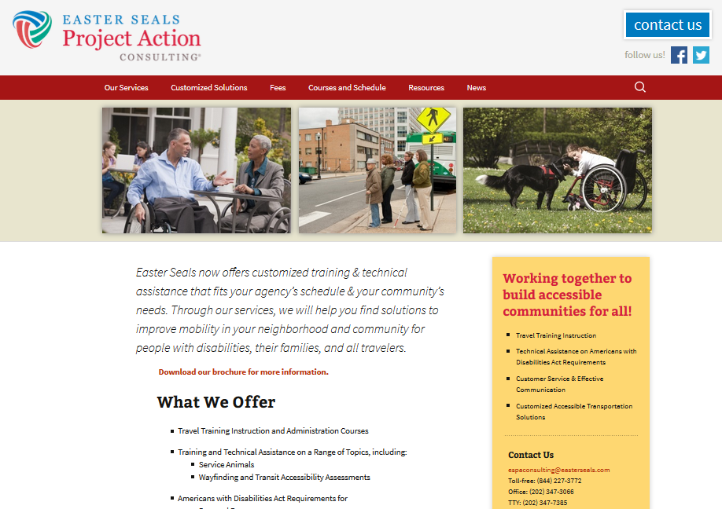
ESPA Consulting
Training
Webinars
Online Courses
In-person workshops
Technical assistance
Via phone – 844-227-3772
Via e-mail – projectaction@easterseals.com
Resources – www.projectaction.org
Notes:
4

Slide 5
To contact us
(844) 277-3772 (toll free)
www.projectaction.com
ESPAConsulting@easterseals.com
Notes:
Here is how to contact us:
844-277-3772
ESPAConsulting@easterseals.com
www.projectaction.com
You can also reach our other transportation projects via this contact information as well.

Slide 6
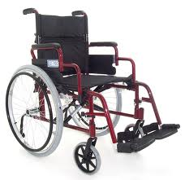
Question
Can an agency require passengers to have brakes and footrests on their wheelchairs?

Slide 7
Answer
No. The DOT ADA regulations define a wheelchair as a mobility aid belonging to any class of three- or more-wheeled devices, usable indoors, designed or modified for and used by individuals with mobility impairments, whether operated manually or powered. The definition does not include a requirement for brakes or any other equipment. A transportation operator may not deny transportation to a wheelchair user because the device does not have brakes or the user does not choose to set the brakes.

Slide 8
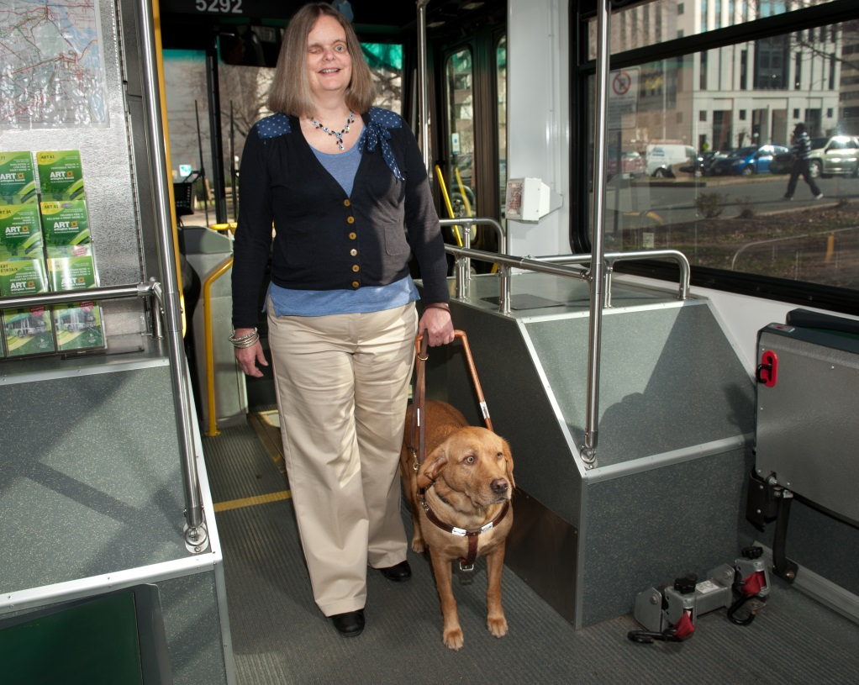
Question
If an operator is afraid of a service animal or allergic to that type of animal, can the driver deny service to the passenger?

Slide 9
Answer
No. A service animal is an extension of the traveler and is a crucial component of the individual’s trip. The passenger would not be denied a ride because of a strong fragrance that the traveler wears, even if it causes a reaction for the operator, so the same applies to service animals. Likewise, fear of a person who is not creating a direct threat is not a reason to deny service, and the same concept applies to transporting service animals.

Slide 10
Question
A passenger is waiting at the stop with a dog and the operator is unsure whether it is a service animal. What can be done at the stop to determine service animal status?

Slide 11
Answer
There are two questions an operator can ask:
Is that a service animal?
What task does the animal perform?
The operator must accept whatever response the passenger provides. The operator cannot ask for any type of proof of service animal status or demonstration of the task.

Slide 12
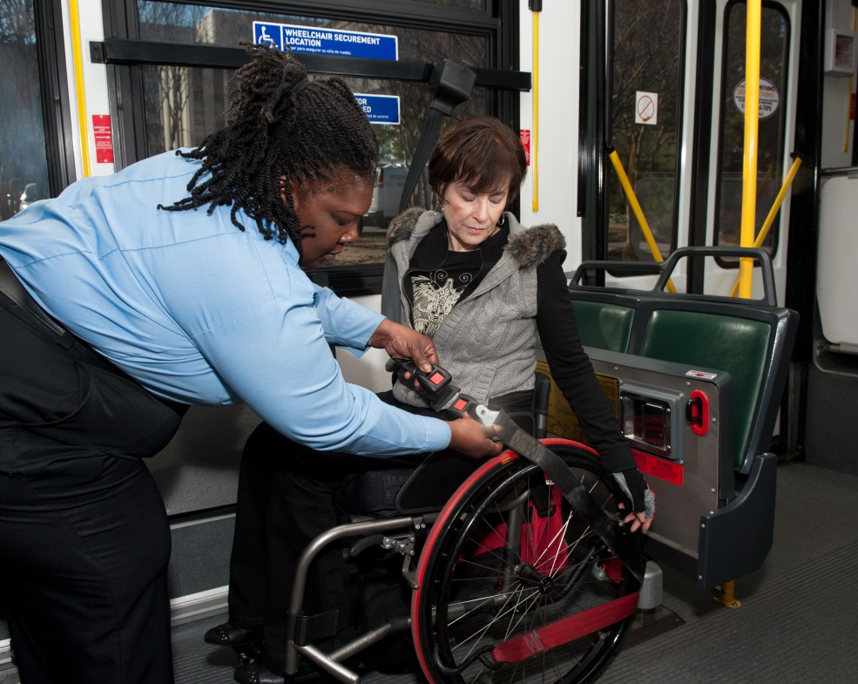
Question
Can you have a policy to require passengers with disabilities to be restrained with seat belts?

Slide 13
Answer
Yes, as long as everyone on the vehicle is required to wear seatbelts. The ADA ensures people with disabilities have equal access to public transportation services. If there’s a policy that all passengers on the vehicle wear seatbelts then that would make the service equal, but singling out passengers with disabilities as the only people to wear seatbelts would be discriminatory.

Slide 14
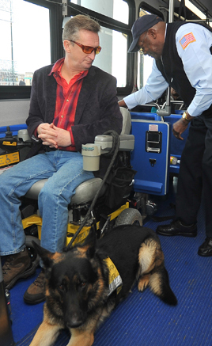
Question
Can you have a mandatory mobility device securement policy?

Slide 15
Answer
Yes. § 37.165 (3) on lift and securement use states that “The entity may require that an individual permit his or her wheelchair to be secured.”
However the regulation also states in 3d that “The entity may not deny transportation to a wheelchair or its user on the ground that the device cannot be secured or restrained satisfactorily by the vehicle’s securement system.”

Slide 16
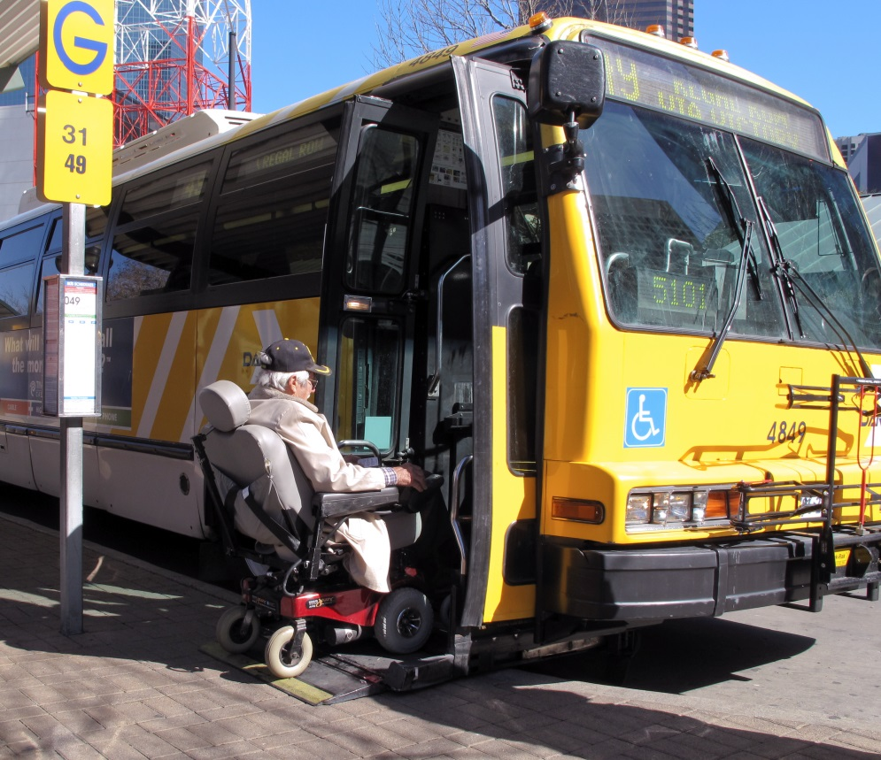
Question
Are lifts and securement areas identified as part of the required pre-trip inspection?

Slide 17
Answer
Yes. Every transit agency has their own policy on how those pre-trip inspections are conducted, but accessibility equipment is to be inspected as a key vehicle component.

Slide 18
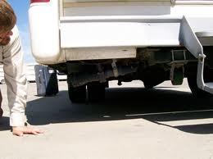
Question
Are bus operators required to refuse a bus during a pre-trip if the lift fails to operate?

Slide 19
Answer
Yes. If inoperative accessibility equipment is found, then the vehicle must be taken out of service and repaired. However, if there is no spare vehicle available, the vehicle can be kept in service for a maximum of three days (for providers operating in an area of over 50,000 population) or five days (for providers operating in an area of 50,000 population or less).

Slide 20
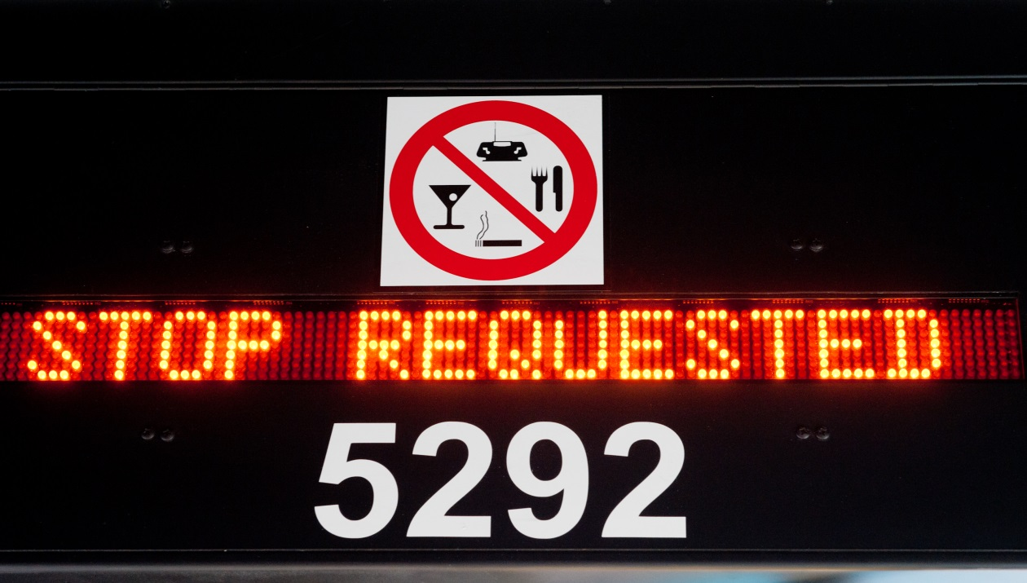
Question
Are all major intersections and bus stops required to be called out to passengers?

Slide 21
Answer
On fixed route systems, stops must be announced:
At transfer points (to either other routes or modes)
At major intersections or destination points (undefined by the ADA – to be determined by the local entity)
At sufficient intervals so passengers with visual impairments can orient themselves
When more than one route serves a stop or station
At the request of a person with a disability

Slide 22
Answer, continued:
On a demand/response or deviated fixed route the driver is not required to call out stops. However, common sense would indicate that many people would benefit from knowing the same information that is required of the fixed route systems. This would become a matter of local policy.

Slide 23
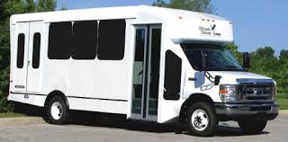
Question
Is it a violation of ADA for a bus operator to report that a lift is inoperable to a passenger with disabilities when it is not broken?

Slide 24
Answer
Yes. This would constitute a denial of service. Again, the ADA is intended to ensure equal access. If the operator provides false information regarding the operating status of equipment that is designed to provide access onto the vehicle, then the operator is denying that individual service.

Slide 25
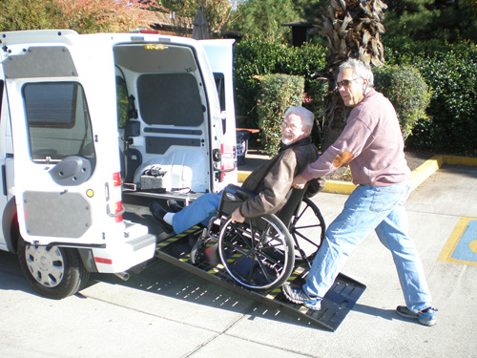
Question
Is a bus operator required to leave their seat to assist a passenger with disabilities by pushing a mobility device into the bus or van?

Slide 26
Answer
Yes. Returning to § 37.165 3f, “where necessary or upon request, the entity’s personnel shall assist individuals with disabilities with the use of securement systems, ramps and lifts. If it is necessary for the personnel to leave their seats to provide this assistance, they shall do so.”

Slide 27
Question
True or False?
Bus operators are required to slightly adjust the boarding location so that an individual with a disability using a wheelchair may board from an accessible location in the event that construction and/or snow would prevent the individual from boarding at the bus stop.

Slide 28
Answer
True! (Effective July 15, 2015)
The Department of Transportation recently issued updates to the ADA with regard to reasonable modifications to policies pertaining to people with disabilities. This was one of the specific examples given as a policy that would need to be modified for people with disabilities to ensure access to transit services.

Slide 29
Question
True or False?
A wheelchair user’s request to board a fixed route or paratransit vehicle separately from his or her device when the occupied weight of the device exceeds the design load of the vehicle lift should generally be granted.

Slide 30
Question
True! (Effective July 15, 2015)
This is also an example provided in the updated ADA regulations as an accommodation that should be granted.

Slide 31
Question
Can passengers with disabilities demand to use the lap and should harness but refuse to allow the mobility device to be secured when the system has no securement policy?

Slide 32
Answer
Passengers can request to use whatever accessibility/securement equipment is available.
If there is no policy requiring securement, and the passenger does not want to be secured, then that individual has the right to decline securement.

Slide 33
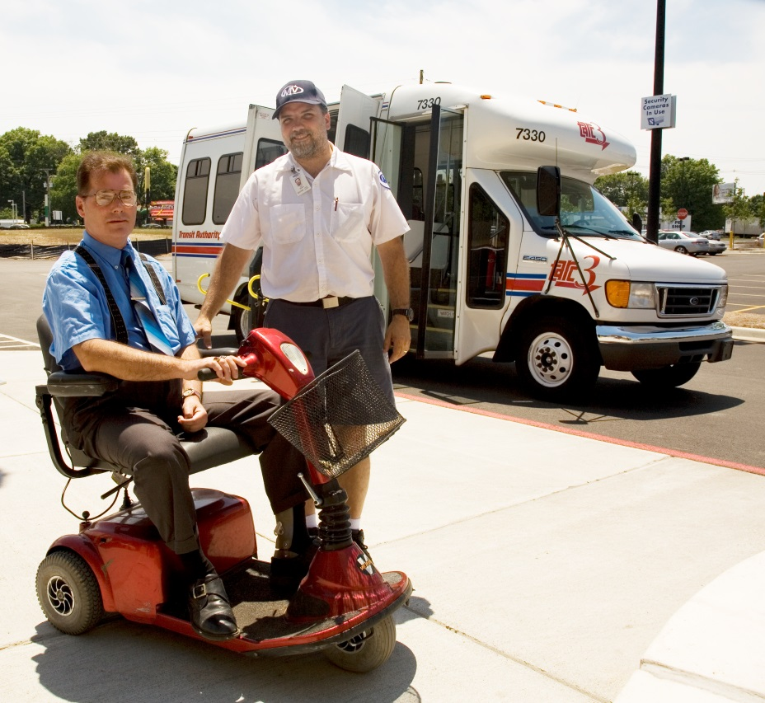
Question
The current definition of a common wheelchair is a device that has a 48” by 30” footprint or a 600 lb. weight limit.
True or False?

Slide 34
Answer
False. The new requirement is that if a lift (or ramp) and vehicle can safely accommodate an individual and their mobility device, then the operator must transport the individual unless doing so would be inconsistent with legitimate safety requirements.
The definition of a “common wheelchair” is language that has been deleted from the regulations.

Slide 35
Question ~ Ask yourself…
Where do you look for the latest resources?

Slide 36
RESOURCES
Check out the FTA web site with information on ADA such as requirements and best practices for vehicle maintenance, stop announcements, eligibility requirements, telephone “hold time” issues, origin to destination policies, on-time performance, and dealing with no-shows.
http://www.fta.dot.gov/civilrights/12325.html

Slide 37
RESOURCES
Another good FTA resource is “Transit and the ADA – Frequently Asked Questions.”
http://www.fta.dot.gov/12325_5110.html

Slide 38
RESOURCES
The Disability Rights Education & Defense Fund (DREDF) funded by FTA and the U.S.DOT brought together the requirements of the ADA regulations, FTA determinations, and operational practices that comply with the ADA in their “Topic Guides on ADA Transportation.”
http://dredf.org/transportation

Slide 39
RESOURCES
Easter Seals Project ACTION website offers information on various topics relating to the ADA and accessible transportation.
http://www.projectaction.org

Slide 40
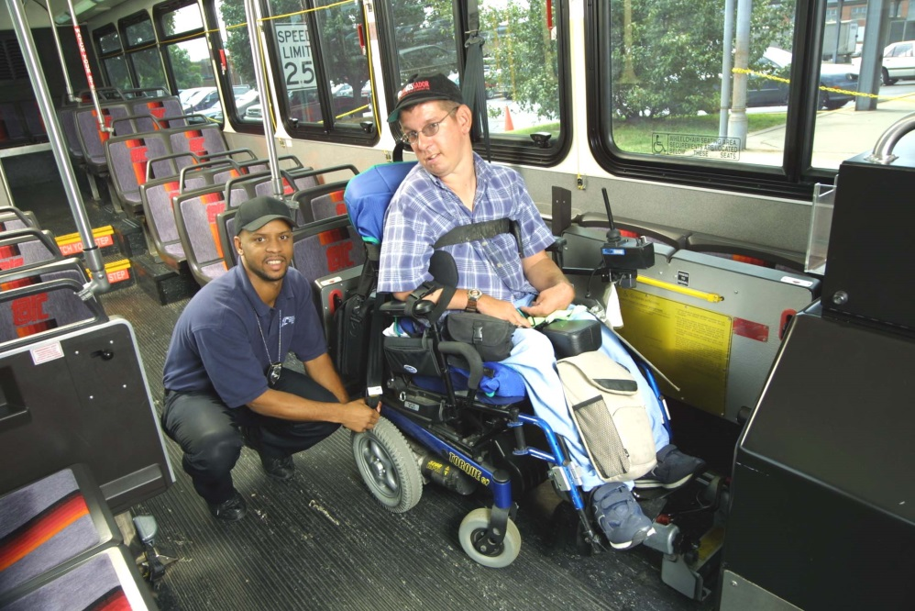
Questions?

Slide 41
Thank you!
1425 K Street NW, Suite 200
Washington, DC 20005
(844) 277-3772
www.projectaction.com
ESPAConsulting@easterseals.com

